Slide 1
BehrendSync Recommendation System
Nick Antonelli, Austin Julio, Travis Smith, Zohair Tharani, Ben Terwilliger

Slide 2

Introduction
Clubs are crucial to the university ecosystem
Behrend uses OrgSync to offer a website for clubs
Students manually have to find clubs manually
To fix that minor problem, Watson Discovery was used to give more accurate results quickly.

Slide 3
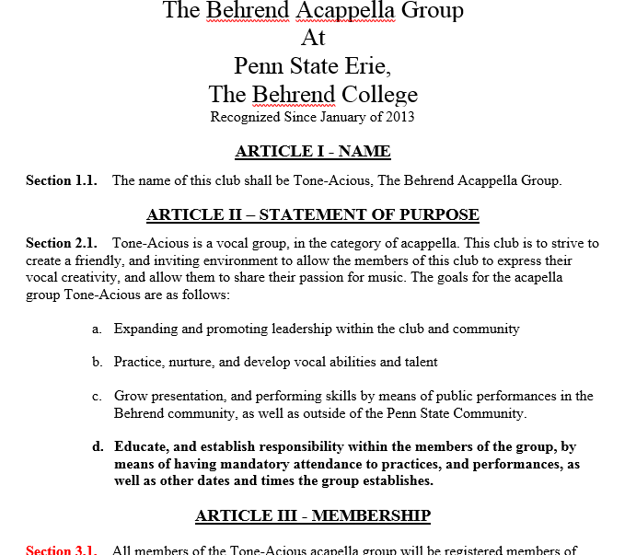
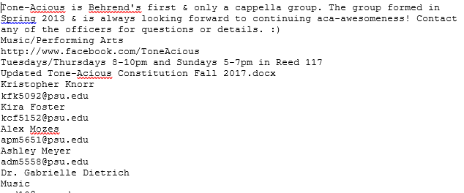
System Implementation
Total samples: 30 clubs of all types
Data grabbed: OrgSync Page details and constitution

Slide 4
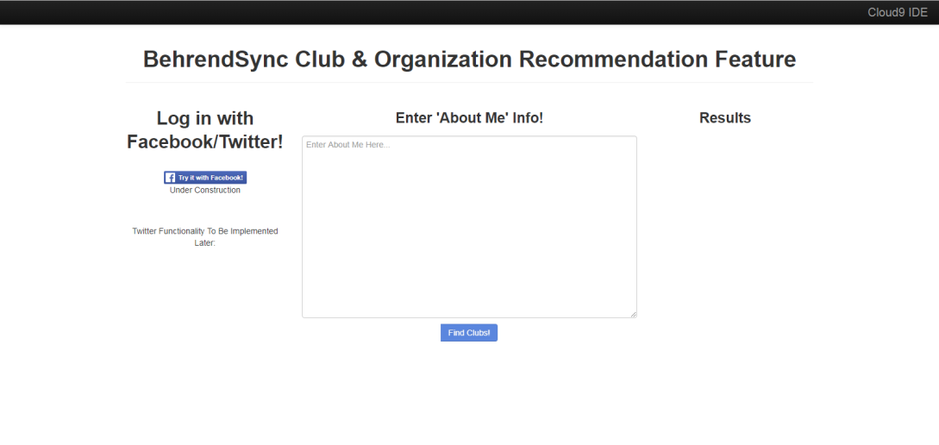
System Implementation
Twitter and Facebook
About me section
Simple and clean front-end design
User does not have to leave the page in order to get recommendations
All information is provided, including the emails of the staff (i.e., president, vice president, club advisor)

Slide 5
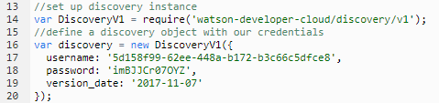
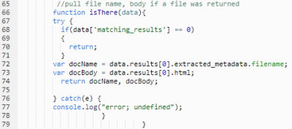
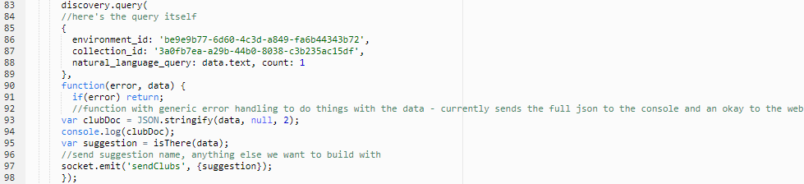
System Implementation

Slide 6
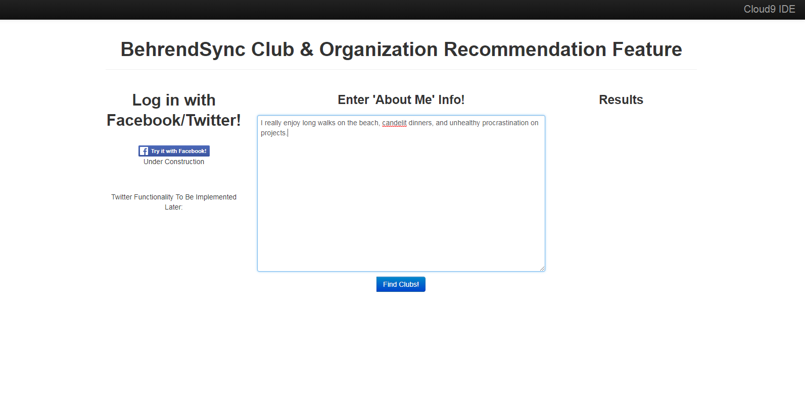
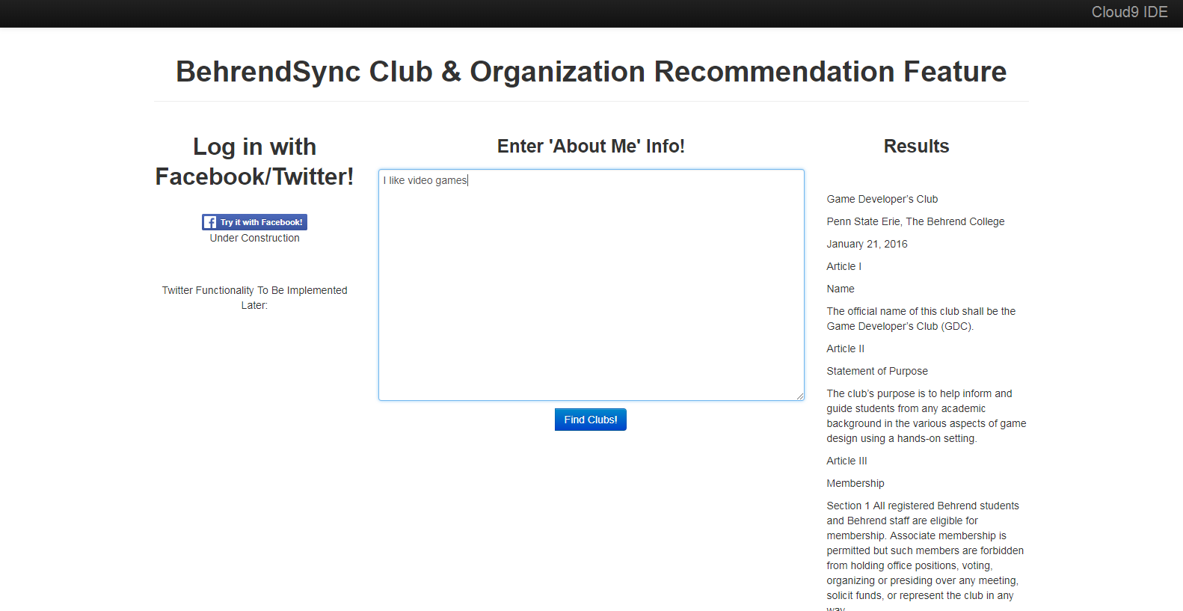
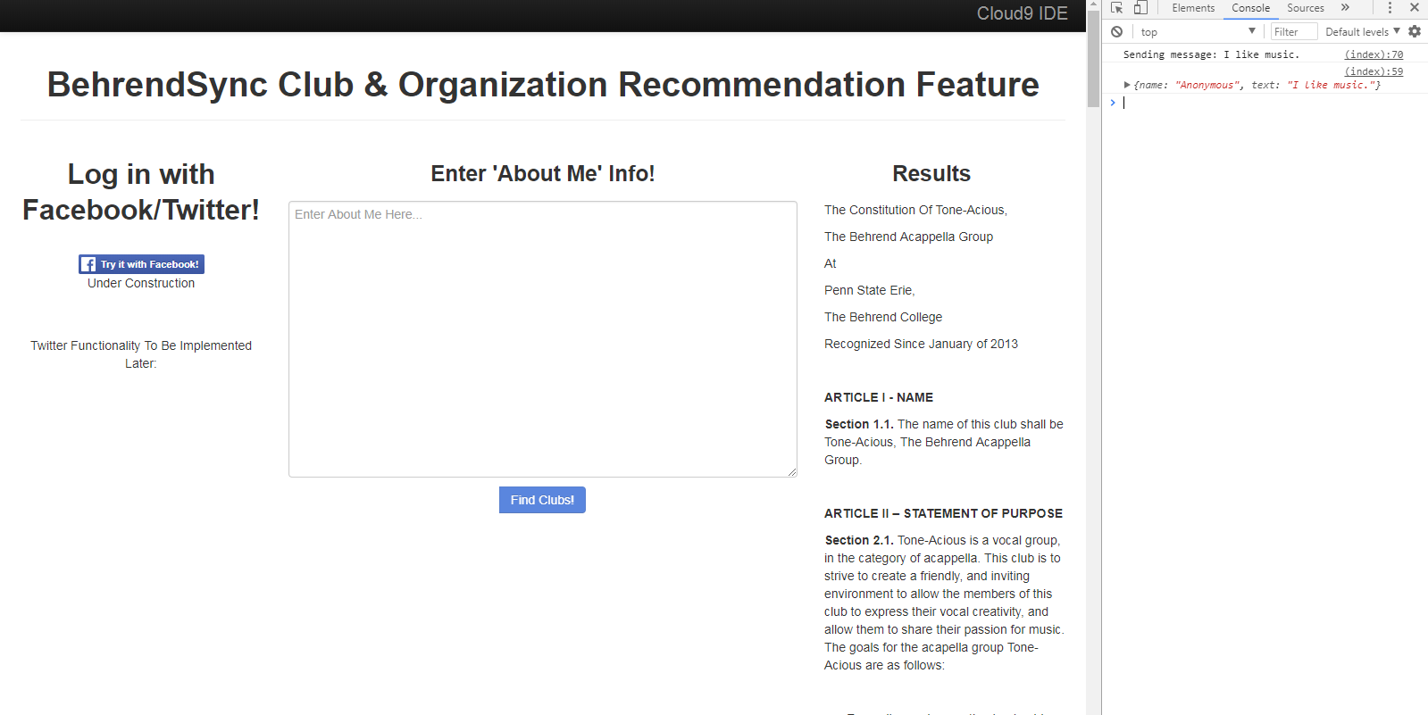
System Implementation

Slide 7
System Improvements
Acquiring OrgSync API would have made process efficient
Implementing Facebook and Twitter
Facebook - Needed to submit app for review to get more detailed user information, such as Likes and About Me
Improving Front-End
Database of Images of Clubs for Front-End

Slide 8
Will It Succeed?
More efficient to search for more clubs
Help students gain exposure and find clubs far easier than before
In short yes, but unfortunately BehrendSync is leaving us

Slide 9
Demo

